Slide 1
MICCAI Paper Reviews
July – 19
Bishal

Slide 2
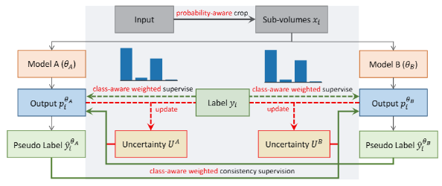
Calibrating Label Distribution for Class-Imbalanced Barely-Supervised Knee Segmentation MICCAI – 2022 May 2022
1
Paper Link
Main Contribution - Class Imbalance Problem
Modify loss function into class aware loss function
Uncertainty aware sampling supervision

Slide 3
Calibrating Label Distribution for Class-Imbalanced Barely-Supervised Knee Segmentation MICCAI – 2022 May 2022
1
Paper Link
Loss -
These weights are determined based on the distribution of labels in the data. Specifically, they count the number of voxels (3D pixels) for each category in the labeled data and construct a weighting coefficient for each category. The weighting coefficient for a category is inversely proportional to its frequency, raised to the power of a constant (1/3 from their experiments)
Uncertainty aware sampling –
Calculates a uncertainty value (how unsure the model is about its predictions)
Creates a binary mask from the uncertainty values of voxels that is used while training the model to focus more on the categories that the model is less confident about.

Slide 4
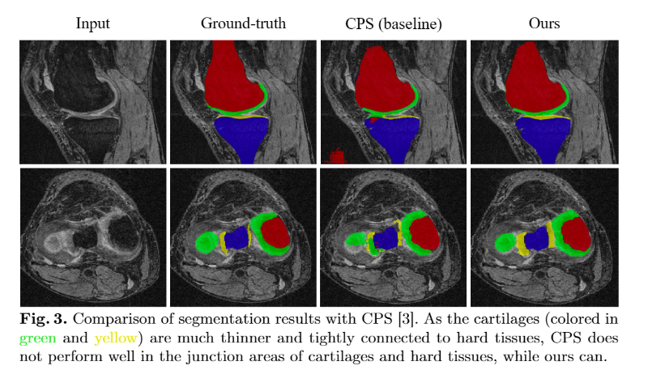
Calibrating Label Distribution for Class-Imbalanced Barely-Supervised Knee Segmentation MICCAI – 2022 May 2022
1
Paper Link
Results
CPS accuracy – 83.6%
Paper accuracy – 87.2%

Slide 5
Exploring Smoothness and Class-Separation for Semi-supervised Medical Image Segmentation MICCAI – 2022 June 2022
2
Paper Link
Main Contribution – Addressing Blur Pixels and Low-contrast regions
Pixel-level Smoothness: This concept is about making sure that the model's predictions don't change too much for small changes in the input image. The authors use a technique called adversarial training to achieve this. They introduce small changes (or perturbations) to the input image and make sure that the model's predictions remain consistent. This is done by comparing the prediction for the original image and the slightly perturbed image, and then adjusting the model to minimize the difference between these predictions. This process helps the model to be more robust and less sensitive to small changes in the input, which is important for tasks like image segmentation.
Inter-class Separation: This concept is about making sure that the model can clearly distinguish between different classes (or categories) in the image. The authors use a prototype-based strategy for this. They first select a subset of features from the labeled data as prototypes for each class. Then, they encourage the features of each class to be close to their corresponding prototype. This helps to make each class distribution compact and separate from other classes. In other words, it helps the model to clearly distinguish between different classes in the image.

Slide 6
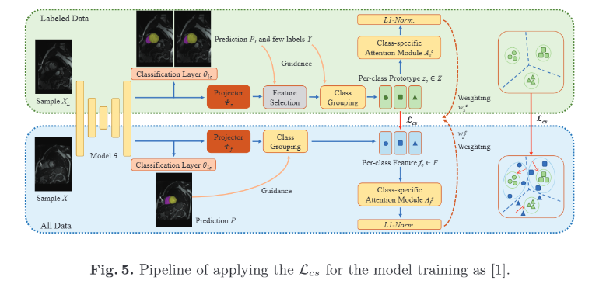
Exploring Smoothness and Class-Separation for Semi-supervised Medical Image Segmentation MICCAI – 2022 June 2022
2
Paper Link

Slide 7
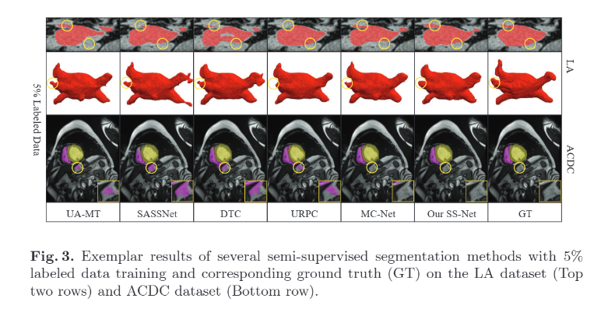
Exploring Smoothness and Class-Separation for Semi-supervised Medical Image Segmentation MICCAI – 2022 June 2022
2
Paper Link
Results
SASSNet accuracy – 81.60 (MICCAI 20)
MC-Net accuracy – 83.59% (MICCAI 21)
Paper accuracy – 86.33% (MICCAI 22)

Slide 8
Free Lunch for Surgical Video Understanding by Distilling Self-Supervisions MICCAI – 2022 Sept 2022
3
Paper Link
Main Contribution – Distilled transfer learning using contrastive learning
Semantic-Preserving Training – Preserve the learnt features from MoCov2 model and learn via contrastive learning
Given an input, two transformations are made and passed through MLP layers to obtain final representations. Contrastive loss (InfoNCE loss) is used to measure the mililarity and compute loss.
The distillation loss is used to measure the difference between the similarity matrices of the teacher model and the student model. The teacher model is the model that has been trained using a semantic-preserving training scheme, and the student model is the model that is being trained on the surgical data.

Slide 9
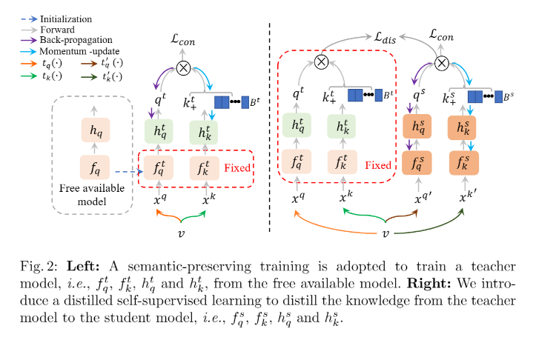
Free Lunch for Surgical Video Understanding by Distilling Self-Supervisions MICCAI – 2022 Sept 2022
3
Paper Link

Slide 10
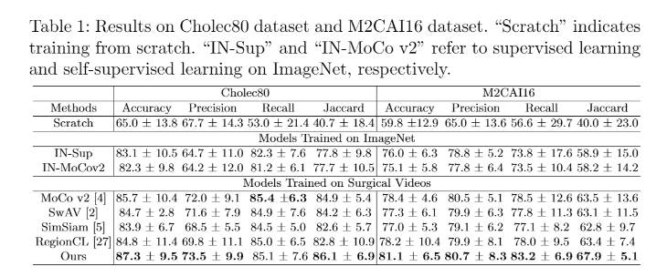
Free Lunch for Surgical Video Understanding by Distilling Self-Supervisions MICCAI – 2022 Sept 2022
3
Paper Link
Results

Slide 11
mmFormer: Multimodal Medical Transformer for Incomplete Multimodal Learning of Brain Tumor Segmentation MICCAI – 2022 Aug 2022
4
Paper Link
Main Contribution – Segmentation even when missing modals
Modality specific encoders – Convolutional encoder + Intra-Modal transformer – To capture local as well as global context within each modality.
Inter-Modal Transformer – long-range correlations across modalities ( relation between different images of same region)
Decoder – Upsampling
Auxiliary Regularizers – The outputs of the convolutional encoders are upsampled by a shared weight decoder per modality (this encourages to perform well even when certain modalities are missing)

Slide 12
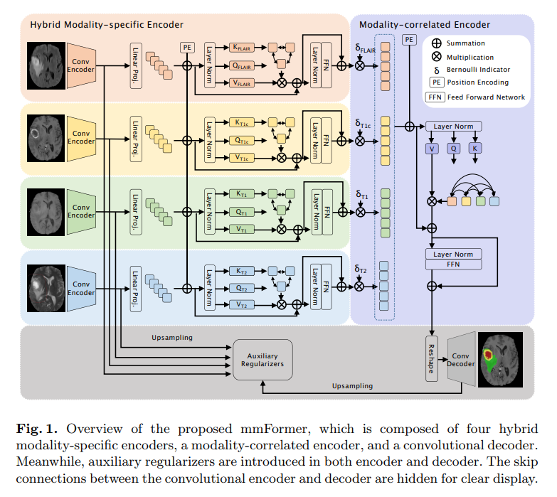
mmFormer: Multimodal Medical Transformer for Incomplete Multimodal Learning of Brain Tumor Segmentation MICCAI – 2022 Aug 2022
4
Paper Link

Slide 13
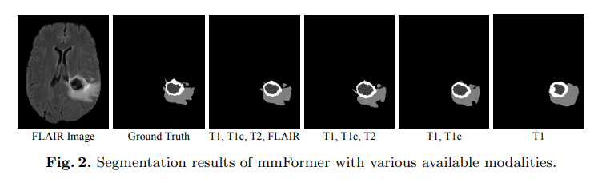
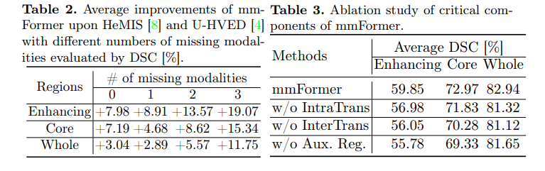
mmFormer: Multimodal Medical Transformer for Incomplete Multimodal Learning of Brain Tumor Segmentation MICCAI – 2022 Aug 2022
4
Paper Link
Results

Slide 14
NVUM: Non-Volatile Unbiased Memory for Robust Medical Image Classification MICCAI – 2022 Aug 2022
5
Paper Link
Main Contribution – Addresses noisy multi-label & Class Imbalance problems
The Non-Volatile Unbiased Memory (NVUM) is a training module proposed in the paper to address the challenges of noisy multi-label and imbalanced learning in medical image analysis.
NVUM stores running average of model logits and this functionality is controlled by a hyperparameter.
NVUM is updated by subtracting the log prior of the class distributions during the memory update, which has the effect of increasing the logits with larger values for the classes with smaller prior.
Uses regularization loss (calculated using stored logits and predicted logits) along with BCE loss to help reduce class imbalance problem.

Slide 15
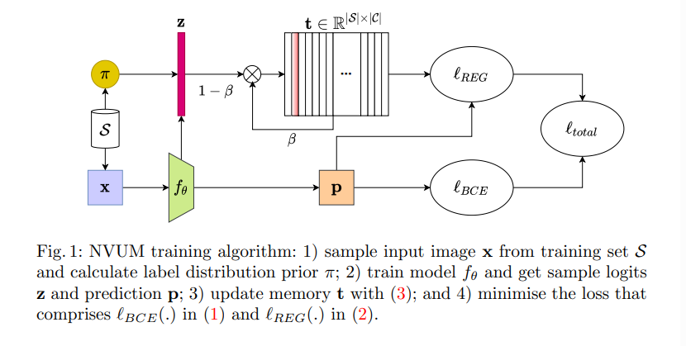
NVUM: Non-Volatile Unbiased Memory for Robust Medical Image Classification MICCAI – 2022 Aug 2022
5
Paper Link

Slide 16
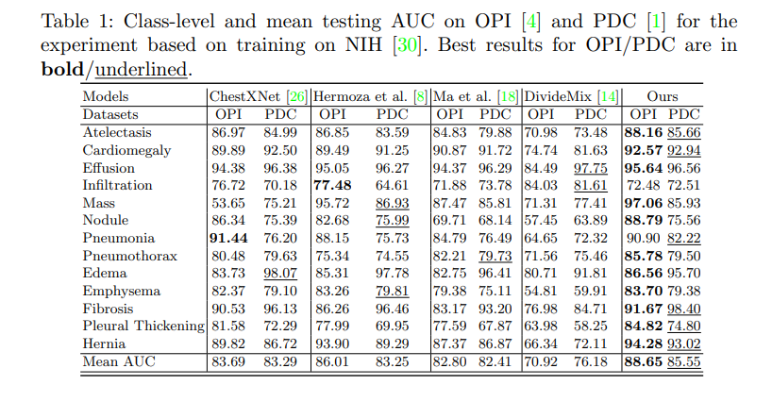
NVUM: Non-Volatile Unbiased Memory for Robust Medical Image Classification MICCAI – 2022 Aug 2022
5
Paper Link
Results

Slide 17
Online Easy Example Mining for Weakly-supervised Gland Segmentation from Histology Images MICCAI – 2022 June 2022
6
Paper Link
Main Contribution – Addresses homogeneity and low color contrast parts
Uses weakly-supervised semantic segmentation (WSSS)
Uses 2 level training –
Creates a pseudo pixel-level mask using Class Activation Masks (CAM) (Calculated by multiplying feature maps from CNN with weights of classifier).
The above mask provides a weak supervision for the segmentation task where model has a contextual estimation on where the focusable region.
Uses weighted cross-entropy loss using loss weight maps.
The loss weight maps are calculated using confidence and loss values across categories between the segmentation prediction map and ground truth map.
Models trained on pseudo masks can potentially generalize better to unseen data. This is because the process of generating pseudo masks often involves some form of model uncertainty, which can act as a form of regularization and prevent overfitting to the training data.

Slide 18
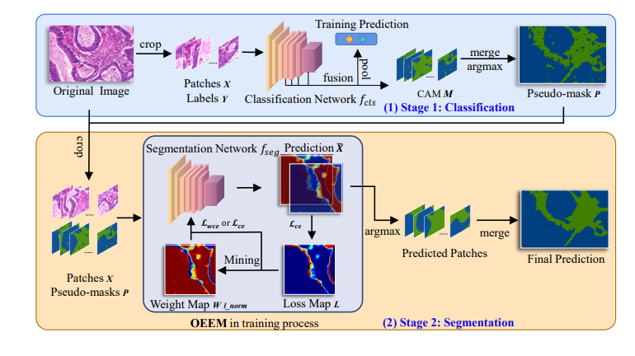
Online Easy Example Mining for Weakly-supervised Gland Segmentation from Histology Images MICCAI – 2022 June 2022
6
Paper Link
Fig. 2. Overview of our proposed
weakly-supervised gland segmentation
method with OEEM.
Classification pipeline for pseudo-mask generation from CAM.
Segmentation pipeline.
We use weighted cross-entropy loss L_wce with weight map Wl_norm for multi-label patches. Here, the glandular tissues are shown in blue and non-glandular tissues are shown in green.

Slide 19
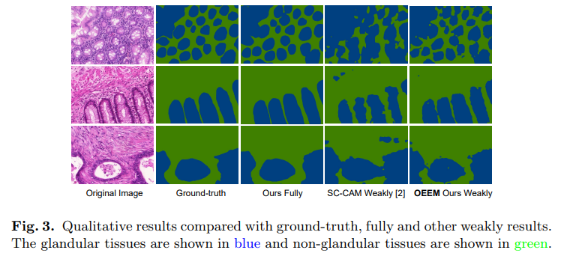
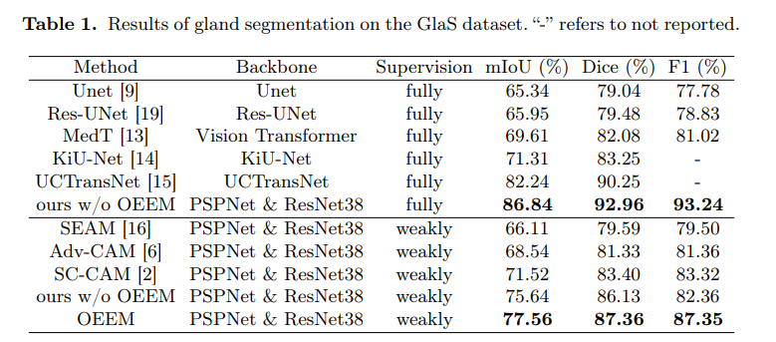
Online Easy Example Mining for Weakly-supervised Gland Segmentation from Histology Images MICCAI – 2022 June 2022
6
Paper Link
Results

Slide 20
Poisson2Sparse: Self-Supervised Poisson Denoising From a Single Image MICCAI – 2022 June 2022
7
Paper Link
Main Contribution – Single-image denoising in biomedical image systems
Sparse Representation - optimizes sparse representation in forward pass using Iterative Shrinkage Thresholding Algorithm (ISTA).
Objective function – minimize the difference between the exponential of the network output and the product of the input image and the network output. This is referred to as LPoisson in the paper.
Poisson2Sparse Training – Trained using random neighbor down-sampling. It creates image pairs that are similar in appearance but are slightly different in terms of the ground truth pixels and then tries to minimize the loss function for these pairs.
Regularizer – to avoid blurry images regularizer is introduced which calculates the difference between network output and down-sampled input image pairs

Slide 21
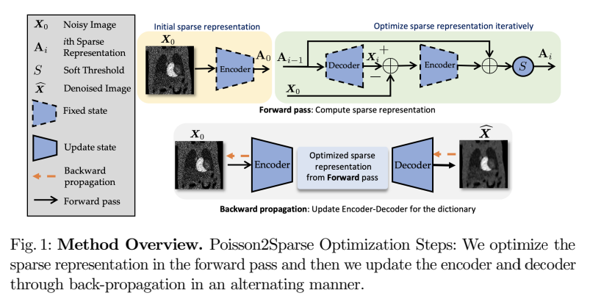
Poisson2Sparse: Self-Supervised Poisson Denoising From a Single Image MICCAI – 2022 June 2022
7
Paper Link

Slide 22
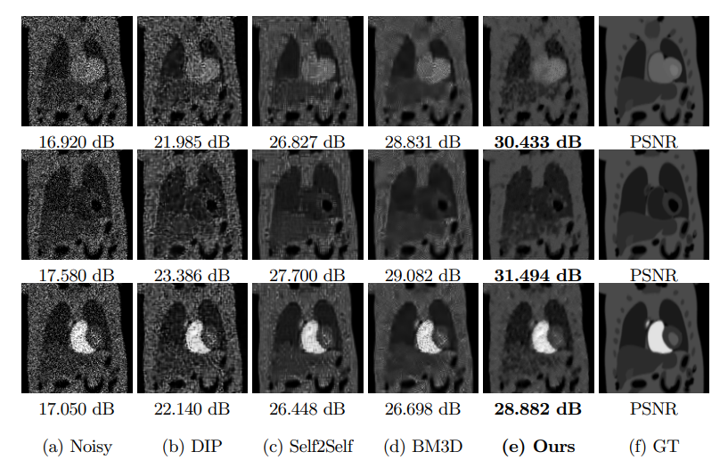
Poisson2Sparse: Self-Supervised Poisson Denoising From a Single Image MICCAI – 2022 June 2022
7
Paper Link
Results

